Slide 1
NPM vs NPX
With Diagrams, Examples & Comparison Table

Slide 2
What is NPM?
• Node Package Manager.
• Used to install & manage dependencies.
• Installs packages locally or globally.
• Example: npm install react

Slide 3
What is NPX?
• Node Package Execute.
• Used to run packages without installing.
• Saves space by avoiding global installs.
• Example: npx create-react-app myapp

Slide 4
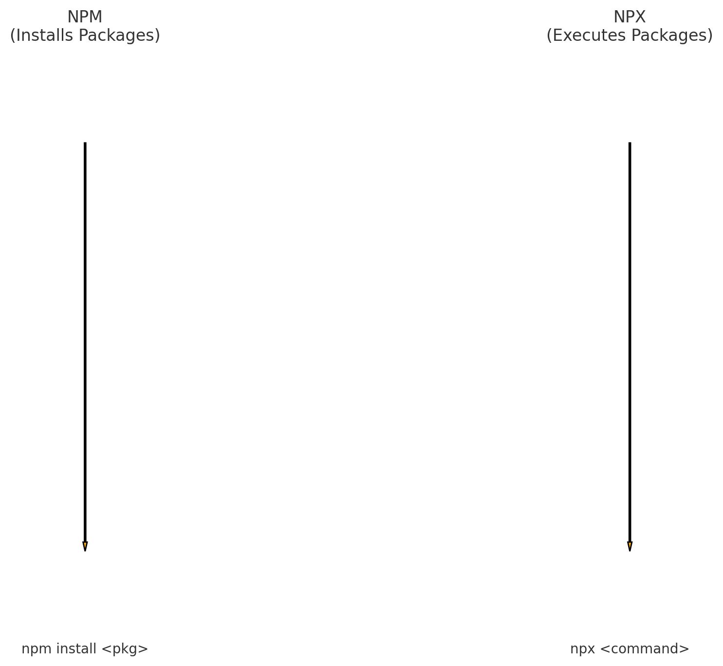
Visual Diagram: NPM vs NPX

Slide 5
Comparison Table
NPM vs NPX:
• NPM installs packages → NPX executes packages.
• NPM creates node_modules → NPX avoids installation.
• NPM commonly used for dependencies → NPX used for CLI tools.
• NPM requires install before use → NPX runs instantly.

Slide 6
Real-World Use Cases
Use NPM when:
• Installing libraries (React, Express)
• Managing project dependencies
Use NPX when:
• Running one-time commands
• Project scaffolding (create-react-app)
• Running tools without installing globally

Slide 7
Examples
NPM Examples:
• npm install axios
• npm update
NPX Examples:
• npx create-react-app demo
• npx tailwindcss init

Slide 8
Summary
• NPM installs packages.
• NPX executes packages.
• NPX helps avoid unnecessary global installations.
• Both are important tools for modern JavaScript development.

